Slide 1
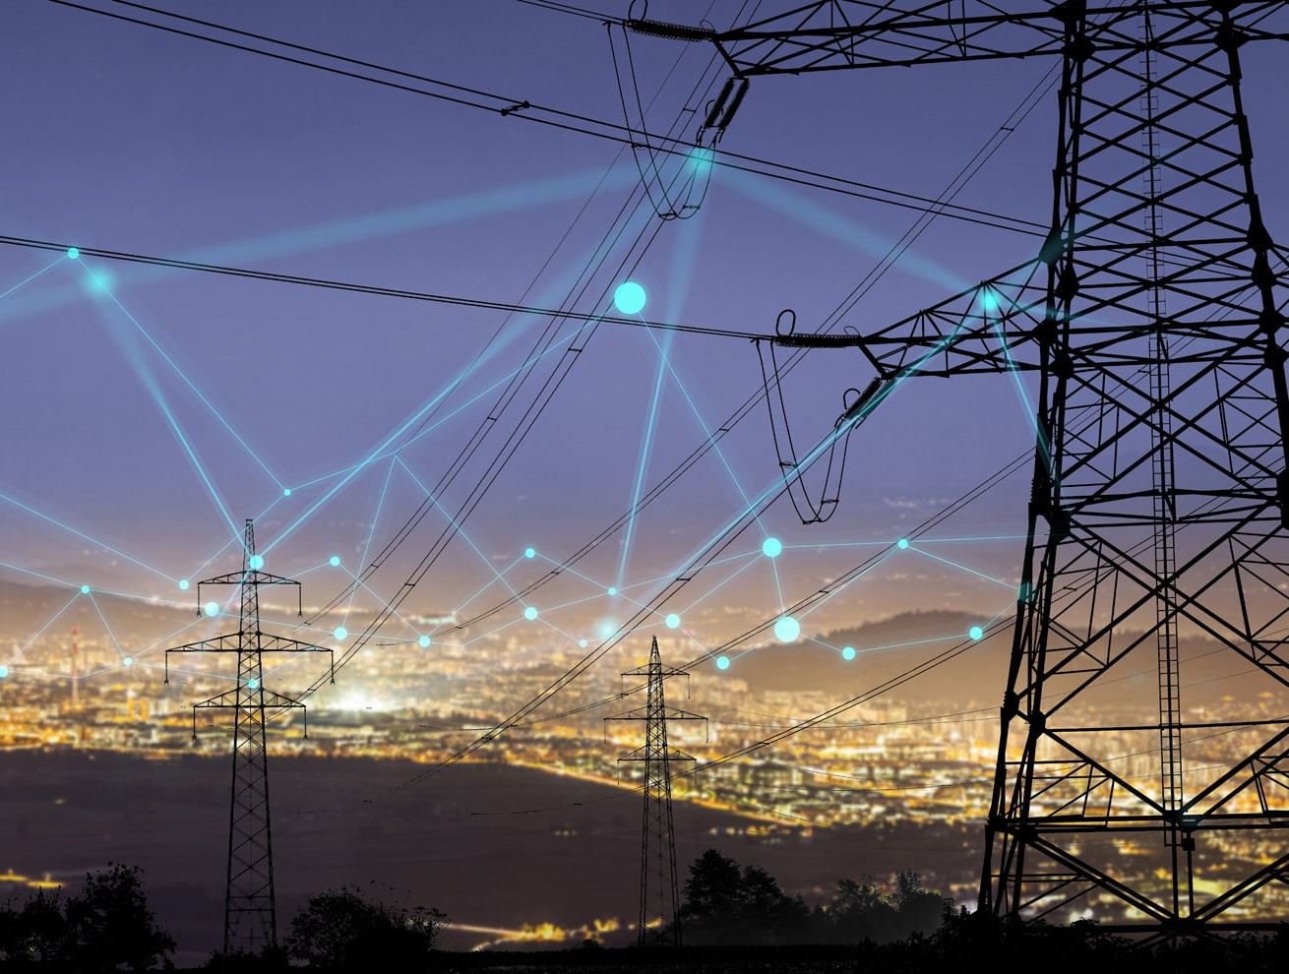
POWER GRID PROJECT
FELIPE BUCHBINDER, YOUNG KIM AND SHOTA TAKESHIMA

Slide 2
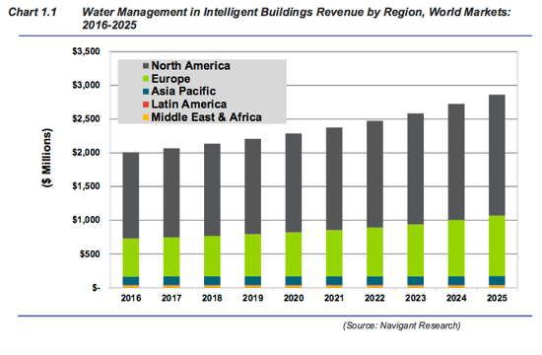
Smart building technologies are a huge and growing market. Investments in water management technologies alone is expected to
grow from $2.0 billion in 2016 to $2.8 billion in 2025

Slide 3
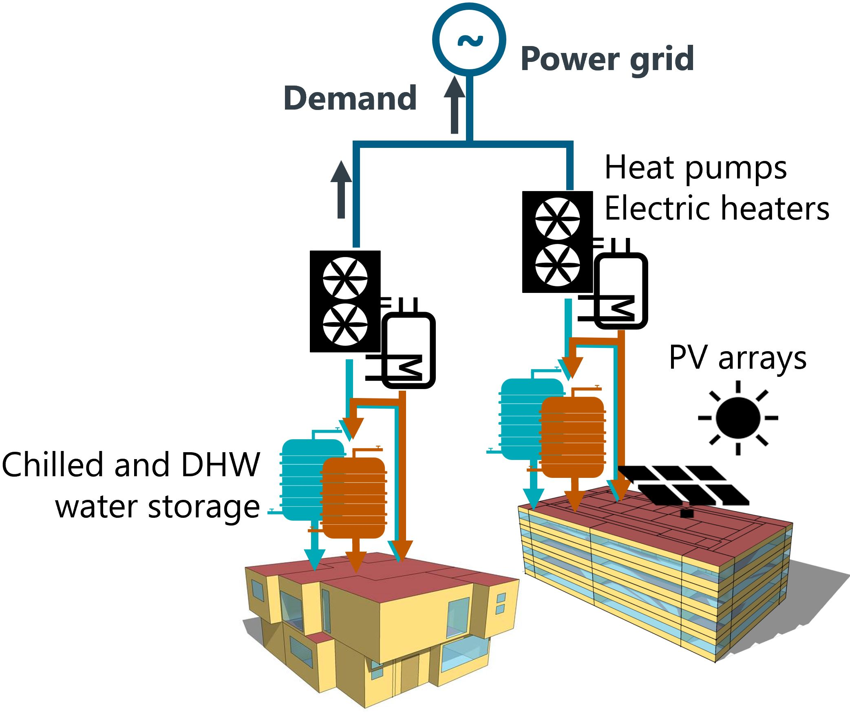
PROBLEM SETTING
Buildings need to heat up or cool down.
They do this by using hot or cold water.
It costs electricity to warm or cool water.
Future cost of electricity is affected by current demand and supply.
If the cost of electricity is low, buildings can heat/cool more water than they need immediately and store it for future use.
If the cost of electricity is high, buildings can use the hot/cold water they had previously stored.

Slide 4
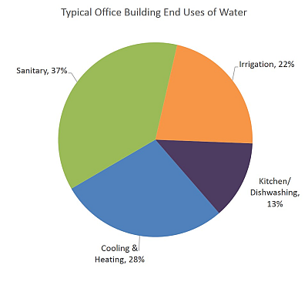
HEATING AND COOLING ACCOUNTS FOR 28% OF WATER CONSUMPTION IN OFFICE BUILDINGS
Source: United States Environmental Protection Agency. https://www.epa.gov/greeningepa/water-conservation-epa. Accessed: 11/02/2020

Slide 5
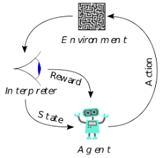
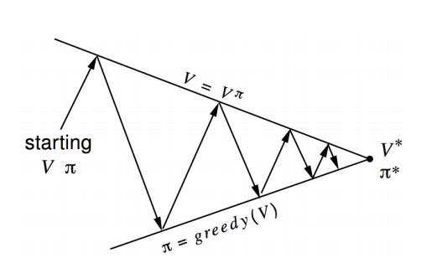
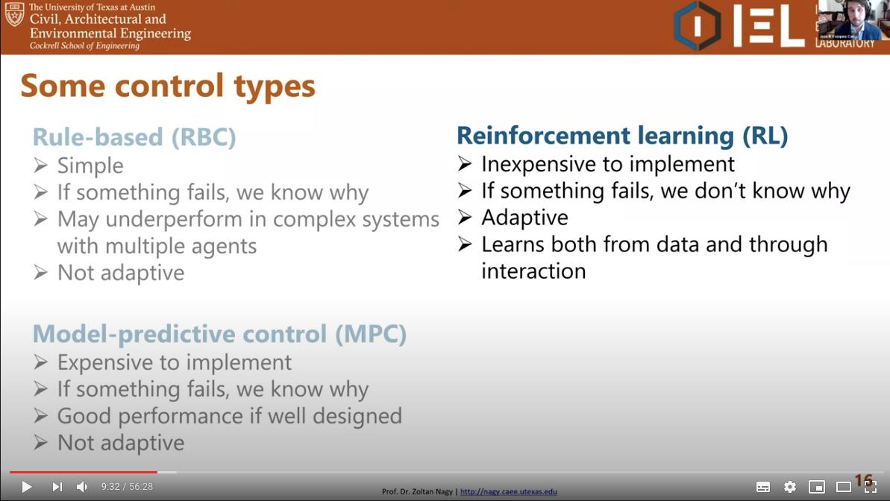
REINFORCEMENT LEARNING
Agent identifies current state. Takes action. Gets reward. Goes to new state.
Goal is to maximize (discounted) value of future rewards (optimal policy).
No knowledge of possible states or transition probabilities required (model free)
Why use RL?

Slide 6
REINFORCEMENT LEARNING METHODS

Slide 7
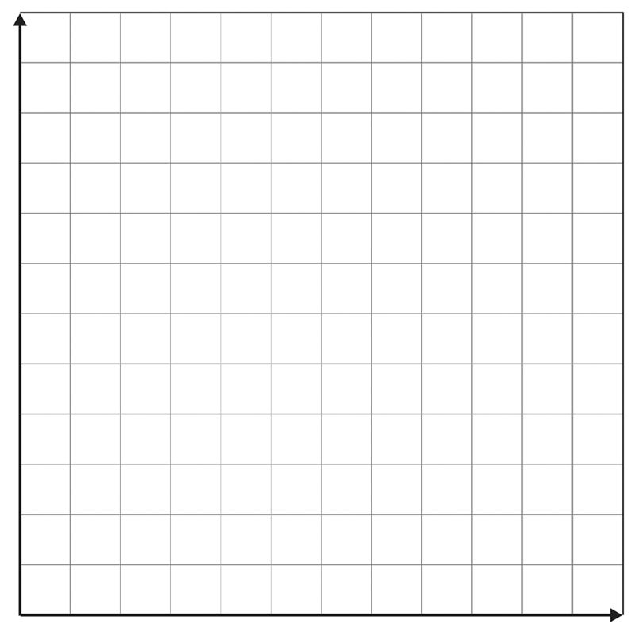
PROBLEM STATEMENT
AS A REINFORCEMENT LEARNING PROBLEM
States: Amount of cold and hot water stored
Actions: Increase / Lower stocks of cold / hot water
Reward in terms of (negative) cost used to cool / heat building
Goal: Find how much hot / cold water to use / store at each time in order to incur in the smallest cost (optimal policy)
Amount of hot water stored
Amount of cold water stored
Notes:
To manage each building's cooling and heating storage with reinforcement learning approach, we first should define, states, possible actions, rewards for each time step, and objectives. About states, states are determined by the current amount of cold and hot storage, weather conditions, electricity generation, and consumption.
Regarding possible action for each building, agents can adjust how much cool and hot water stocks for future cooling and heating.
A higher reward is given when hot and chilled water storages are used to reduce electricity consumption during higher demand periods. In the later slide, we explain more about some types of rewards.
The goal is to incur the smallest cost in terms of all buildings' total energy consumption.
Using the simple example in the right figure, we show an overview of how the agent determines action. At any given time, the building has a certain amount of cold water and hot water stored. That's his state. The building can then change his state, for example, by increasing the amount of cold water, as we see here. This will be a good thing if temperature rises and the cost of electricity increases, because he will be able to use this cold water to cool it down. This will be a bad thing if temperature falls or electricity becomes cheap.

Slide 8
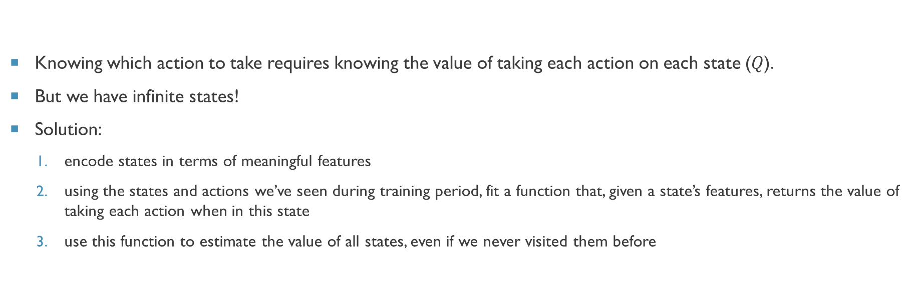
PROBLEM STATEMENT
AS A DEEP REINFORCEMENT LEARNING PROBLEM
Notes:
So, if we know the future return of taking each action on each state, we can get an optimal policy.
However, unlike the simple example, in the actual problem, states are determined by continuous variables. And, the number of variables is not a few, about 30, as I introduced in the previous slide.
Therefore, we need to consider the infinite state. One possible approach is to use a deep network to calculate the future return, Q value, for each action on each state.
First, we calculate the meaningful features that represent the state well from 30 variables. This is the encoding process. And, then we collect the pairs of state features and action in the training process. Using these samples, we train the deep network whose inputs are states feature and action and output is Q value. Using the network, we can interpolate and calculate Q value even if state and action are ones we've never seen.

Slide 9
SIMULATOR ENVIRONMENT
City Learn
“an open source OpenAI Gym environment for the implementation of Multi-Agent Reinforcement Learning (RL)”
“Its objective is to facilitate and standardize the evaluation of RL agents such that different algorithms can be easily compared with each other.”
Each agent manages each building (possibly exchanging information)
Optimize “glocally”
Notes:
As our environment simulator, we use CityLearn. CityLearn is created based on OpenAI gym which is the most popular framework and simulator sets for reinforcement learning.
It's an open-source simulator and it helps to evaluate various reinforcement learning algorithms to manage energy gird because it includes models related to energy consumption and generation, such as Heatpump, PVs, and storages.
Also, it supports multiple-agent reinforcement learning. This means each agent manages each building and we can find an optimal policy locally for each building as well as globally in all buildings. CityLearn allows adding buildings according to arbitrary configuration files, so it also provides a scalable environment for reinforcement learning.

Slide 10
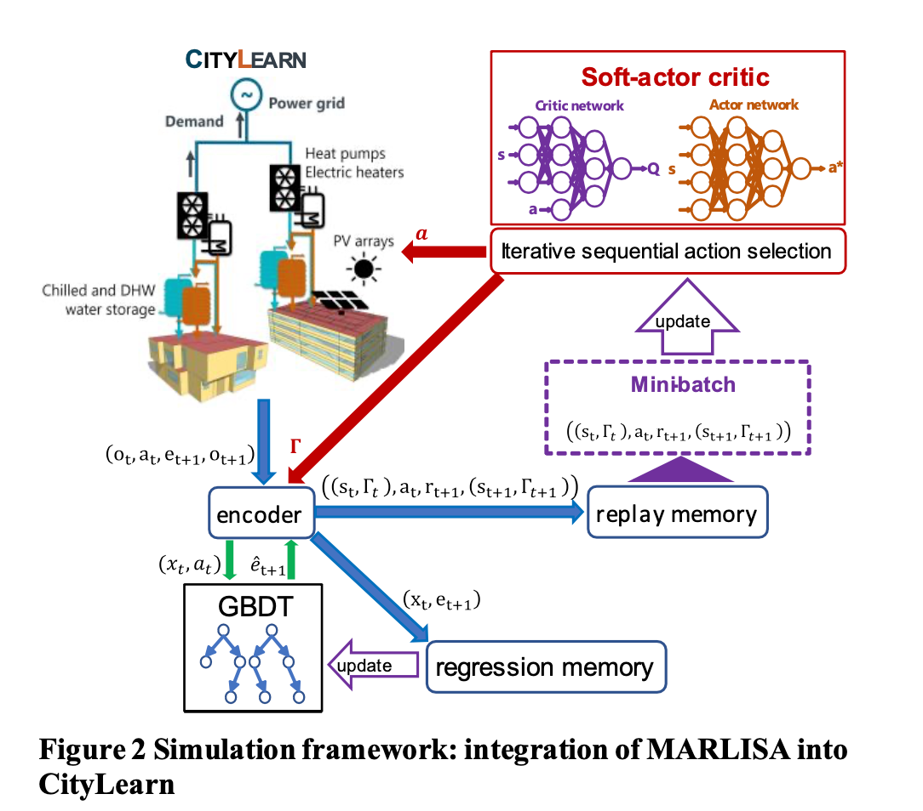
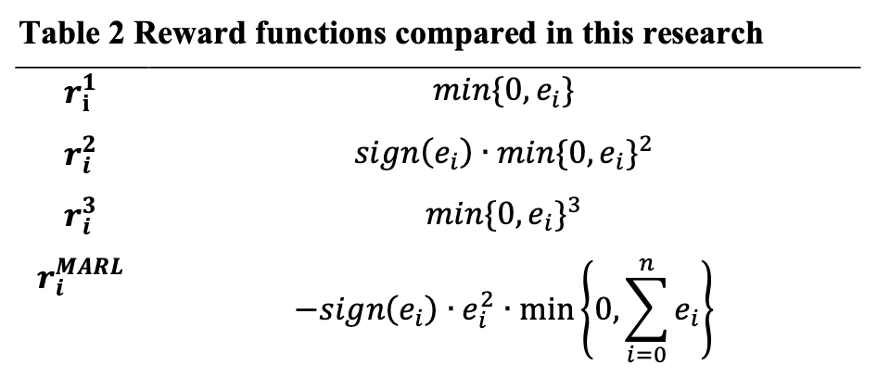
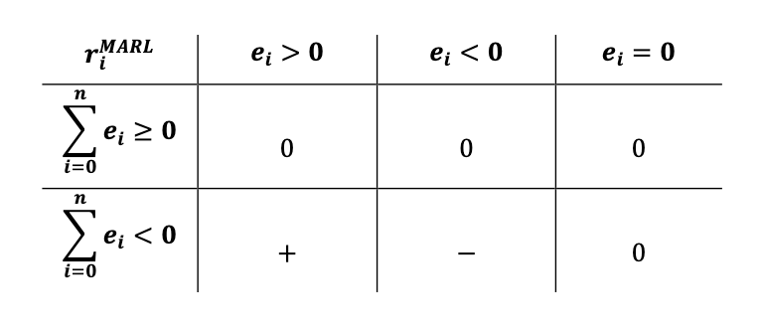

MARLISA: Multi-Agent Reinforcement Learning with Iterative Sequential Action Selection for Load Shaping of Grid-Interactive Connected Buildings
Source: Vázquez-Canteli, José & Henze, Gregor & Nagy, Zoltán. (2020). MARLISA for Load Shaping of Grid-Interactive Connected Buildings. 10.1145/3408308.3427604.
Notes:
Our next step was to replicate this original paper and understand how the algorithm works, especially look at its limitation to make improvement.
One of the purpose of this paper was whether sharing information on electricity consumption among agents would make agents to make better decision in electricity consumption.
If we look at the reward function table on the right we would be able to see r1, r2, and r3 and they are the baseline reward function without sharing information. It punishes the agent when it consumes more generate more electricity. R marl is the reward function that original scholar came up with to share information among agents. Now this reward function not only consider consumption of individual agent but also consider consumption of entire district. This reward function only punishes the agent when the individual and whole district consume more than generate electricity.
The left figure in the slide is a pipeline that original scholar used to train and evaluate rl algorithm. It will first generate some states from the simulator and would use pca to reduce dimension by 75%. It will gradient boosting decision tree to estimate electricity consumption of entire district, which is information sharing part. Use states and estimate as input to actor network to generate new actions. This action will be inserted into simulator to create new states and reward. For each simulation we will save states, estimates, action, and reward into replay buffer, which will be used later use to update critic and actor network.
We used SAC, critique network will approximate each state-action value and action network will predict an action that will generate most reward from looking at state-action value.

Slide 11
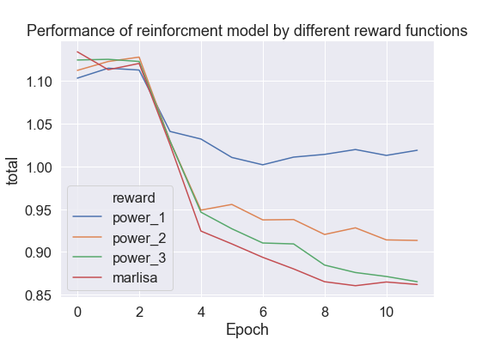
MULTIPLE AGENTS SIMULATIONS
Score
ramping: sum(|e(t)-e(t-1)|), where e is the net non-negative electricity consumption every time-step.
1-load_factor: the load factor is the average net electricity load divided by the maximum electricity load.
average_daily_peak: average daily peak net demand.
peak_demand: maximum peak electricity demand
net_electricity_consumption: total amount of electricity consumed
Notes:
We were able to replicate the results. If we look at the line graph, x-axis represent each epoch or each year of simulation. Y-axis represent a score, which is the average score of five different objectives as listed right side. Basically objective is to smooth the demand curve and decrease electricity consumption as much as possible. The score for each objective is not actual score but relative performance compared to rule-based controller, which makes decision to consume electricity at 8 pm at every case. If the algorithm score more than 1, then it means it is doing worse than rule-based controller and vice versa.
As we could see in the lines for three baseline algorithm, the higher power reward function tends to do a better job, in other word punishing more for consuming more electricity tend to result in better policy. Furthermore, from the graph we could Marlisa outperforms all those baseline model.

Slide 12
NEXT STEPS
Try different techniques for encoder
Try different techniques other than Gradient Boosting Decision Tree
Incorporate volatility into reward function
Incorporate pricing function into the simulation (optional)
Notes:
Our goal for next semester is to improve the model. First looking at highlighted box on the diagram for the pipeline, we could make some improvement with techniques that they had used. Instead of using pca, linear transformation technique, we could use more advanced techniques as auto correlation, a non linear transformation technique. Also, instead of using gradient boosting decision tree, we could use recurrent neural network to improve our estimate of electricity consumption of entire district.
We could also make improvement in reward function.
Instead of just considering total consumption we could use moving variance as a measurement of whether the demand curve flatten or not.
Lastly our next possible step is to incorporate a price function into the simulator.
Our hope one of them would help us to improve the model
We also see some of the improvement that could be made in the reward function. We are planning to incorporate a volatility measurement into a reward function. From looking at some of the research paper from finance, they used moving variance to measure the volatility of a stock, which we could use for demand curve to punish if the demand curve is not flattened.
Lastly our next possible step is to incorporate a price function into the simulator. However, since we don’t have the domain knowledge it would be hard for us to know how price works in energy market.

Slide 13

THANK YOU

